Slide 1

CS1010: Programming Methodology
UNIT 13
Call Stack

Slide 2
Unit 13: Call Stack
Stack Frame
Call Stack

Slide 3
Variables - redux
What is a variable?
It is a location in the memory that holds a value.
Why do we need to declare variables?
The declaration is needed so that the computer can
Allocate the right number of bits in memory for the variable
Interpret the value of the variable accordingly
Where do we declare variables?
Inside functions!

Slide 4
Function Call - redux
What is a function call?
A function call performs the specified task of the function
What task is performed when the following main() function is called?
Variable x is declared and initialized to 1
Variable y is declared.
int main()
{
long x = 1;
long y;
…
}

Slide 5
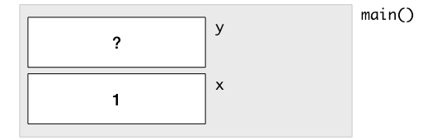
Stack Frame
What happens (in the memory) when you call this function…
A Stack Frame is created for main()
Some space is allocated to for variable x in the Stack Frame.
The value 1 is stored into this space.
Some space is allocated for variable y in the Stack Frame.
Stack Frame: The memory allocated to a function for storing parameters / variables (among other things).
int main()
{
long x = 1;
long y;
…
}

Slide 6
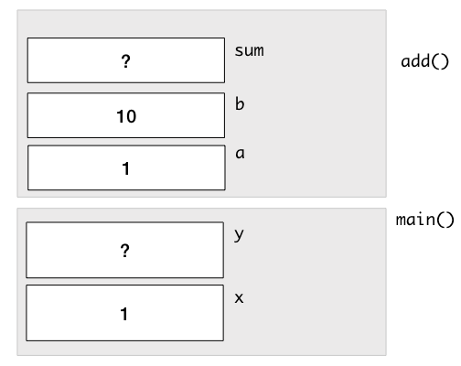
Call Stack
A Stack Frame is added to the Call Stack whenever a function is called.
long add(long a, long b) {
long sum;
sum = a + b;
return sum;
}
int main()
{
long x = 1;
long y;
y = add(x, 10);
…
}
Why a and b have the values of 1 and 10?
The Call Stack after sum is declared in add().

Slide 7

Call Stack
long add(long a, long b) {
long sum;
sum = a + b;
return sum;
}
int main()
{
long x = 1;
long y;
y = add(x, 10);
…
}
The Call Stack after sum is computed in add().

Slide 8
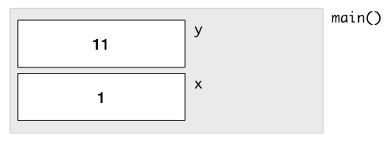
Call Stack
A Stack Frame is removed from the Call Stack after the function has completed.
long add(long a, long b) {
long sum;
sum = a + b;
return sum;
}
int main()
{
long x = 1;
long y;
y = add(x, 10);
…
}
Why y has the value of 11?
The Call Stack after add() has been completed

Slide 9
Call Stack
Each Stack Frame is independent from another.
long add(long a, long b) {
long x;
x = a + b;
return x;
}
int main()
{
long x = 1;
long y;
y = add(x, 10);
…
}
The Call Stack after x is computed in add().

